Slide 1
AI developer bootcamp: Introduction
James Carpinter
CTO, Zarmada | Microsoft Regional Director
james@zarmada.com | @jamescarpinter

Slide 2
Welcome

Slide 3
Overview
Class hours
9 AM – 5 PM
Meals & breaks
10:30 – 11 AM: Break
12 - 1 PM: Lunch
3 – 3:30 PM: Break
Restrooms
<>
Internet connectivity
MSFTWIFI / Microsoft
Q+A
9 – 9:30 | Introduction
9:30 – 10:30 | Bots
10:30 – 11 | Break
11 – 12 | Language & Knowledge
12 – 1 | Lunch
1 – 2 | Speech
2 – 3 | Vision
3 – 3:30 | Break
3:30 – 4:30 | Cognitive Toolkit
4:30 – 5 | Q+A

Slide 4
1. What is artificial intelligence?

Slide 5

Artificial Intelligence
“Intelligence exhibited by machines […] mimicking functions associated with human minds” - Wikipedia
Reasoning
Understanding
Interacting
Learn and form conclusions with imperfect data
Interpret meaning of data including text, voice, images
Interact with people in natural ways

Slide 6

Why now?
Sphinx voice recognition
1992
Powerful algorithms
Grant calculator
1877
Shakey reasoning robot
1969
Compute power
VaMP self-driving car
1994
Big Data
AT&T Voder
1939
GUI
1981
Mechanical
Electronics
Computers
Cloud + AI

Slide 7
AI
ML
NN

Slide 8
2. What can it do for me?

Slide 9

AI for your business
$1.2T
estimated additional revenue/shifting revenue driven by AI in three years
Reasoning
Understanding
Interacting
Leverage your unique data and augment your business in new, unimaginable ways
Interpret business and customer data in real time and scale including text, docs, images, video, voice
Remove technology barriers with customers and multiply employee capabilities
Source: IDC

Slide 10
Digital Transformation + AI
Engage your customers
Transform your products
Artificial Intelligence
Enable your employees
Optimize your operations

Slide 11
Digital Transformation + AI
Conversational agents
Customized experiences
Customer analytics
Engage your customers
Transform your products
Artificial Intelligence
Enable your employees
Optimize your operations

Slide 12


Engage your customers
Bank of Kochi
Customer need
New engagement models with their customers to scale hospitality services at bank branches
Impact
AI-based reception service providing high quality hospitality services with remote in-person escalation
Speech and face emotion recognition creates personal connection with customer

Slide 13
Digital Transformation + AI
Engage your customers
Transform your products
Artificial Intelligence
Employee productivity
Business data differentiation
Organizational knowledge
Enable your employees
Optimize your operations

Slide 14


Enable your employees
Customer need
Fast innovation required to compete
Large data sets to exploit
Impact
Automated predictions on car performance
Real time simulations and collaboration to increase agility
Increased ability to quickly update under changing environments

Slide 15
Digital Transformation + AI
Engage your customers
Transform your products
Artificial Intelligence
Enable your employees
Optimize your operations
Intelligent predictions
Operational efficiency
Deep insights

Slide 16


Optimize your operations
Customer need
High cost of fuel
Determining when to perform engine maintenance
Impact
Massive savings across the life of an engine
Innovative insights in aircraft management

Slide 17
Digital Transformation + AI
Engage your customers
Transform your products
Product innovation
Differentiated experiences
New scenarios
Artificial Intelligence
Enable your employees
Optimize your operations

Slide 18


Transform your products
Customer need
Massive scale needed (1.5 billion users)
Large base of enterprise customers (240 of Fortune 500)
Impact
Ability to combine custom customer data and weather
New high-value services for custom business predictions

Slide 19
Classification
Regression
Anomaly
Clustering
Reinforcement
Which category?
How much? How many?
Is it weird?
How is it organized?
What’s next?
Five questions by Brandon Rohrer

Slide 20
3. What does Microsoft offer?

Slide 21
AI Platform
Comprehensive data
Business solutions

Slide 22
AI innovation provided as a fast and agile platform
AI Platform

Slide 23

Breakthroughs in vision
Spider
152 layers
RESNET

Slide 24
Loud and clear
Speech-recognition word-error rate, selected benchmarks, %
Breakthroughs in speech
Switchboard
5.9% human error rate
Switchboard cellular
Meeting speech
Broadcast speech
Switchboard
IBM, Switchboard
5.8%
Microsoft, Switchboard
1993 | 1996 | 1998 | 2000 | 2002 | 2004 | 2006 | 2008 | 2010 | 2012 | 2014 | 2016
Sources: Microsoft: research papers

Slide 25

Cognitive Services
Vision
Language
Speech
Search
Knowledge
Computer Vision
Face
Emotion
Content Moderator
Video
Video Indexer
Labs
Text Analytics
Spell Check
Web Language Model
Linguistic Analysis
Translator Text
Speaker Recognition
Speech
Translator Speech
Web Search
Image Search
Video Search
News Search
Entity Search
Autosuggest
Academic Knowledge
Entity Linking
Knowledge Exploration
Recommendations
QnA Maker

Slide 26

Cognitive Services
Vision
Language
Speech
Search
Knowledge
Computer Vision
Face
Emotion
Content Moderator
Video
Video Indexer
Labs
Text Analytics
Spell Check
Web Language Model
Linguistic Analysis
Translator Text
Speaker Recognition
Speech
Translator Speech
Web Search
Image Search
Video Search
News Search
Entity Search
Autosuggest
Academic Knowledge
Entity Linking
Knowledge Exploration
Recommendations
QnA Maker
Custom
Custom
Custom
Custom
Custom
Vision
Language Understanding
Speech
Search
Decision

Slide 27






Why Cognitive Services?
Easy
Flexible
Tested
Roll your own with REST APIs
Simple to add: just a few lines of code required
Make the same API code call on iOS, Android, and Windows
Integrate into the language and platform of your choice
Bring your own data for your custom experience
Built by experts in their field from Microsoft Research, Bing, and Azure Machine Learning
Quality documentation, sample code, and community support
GET A KEY
BUILD

Slide 28
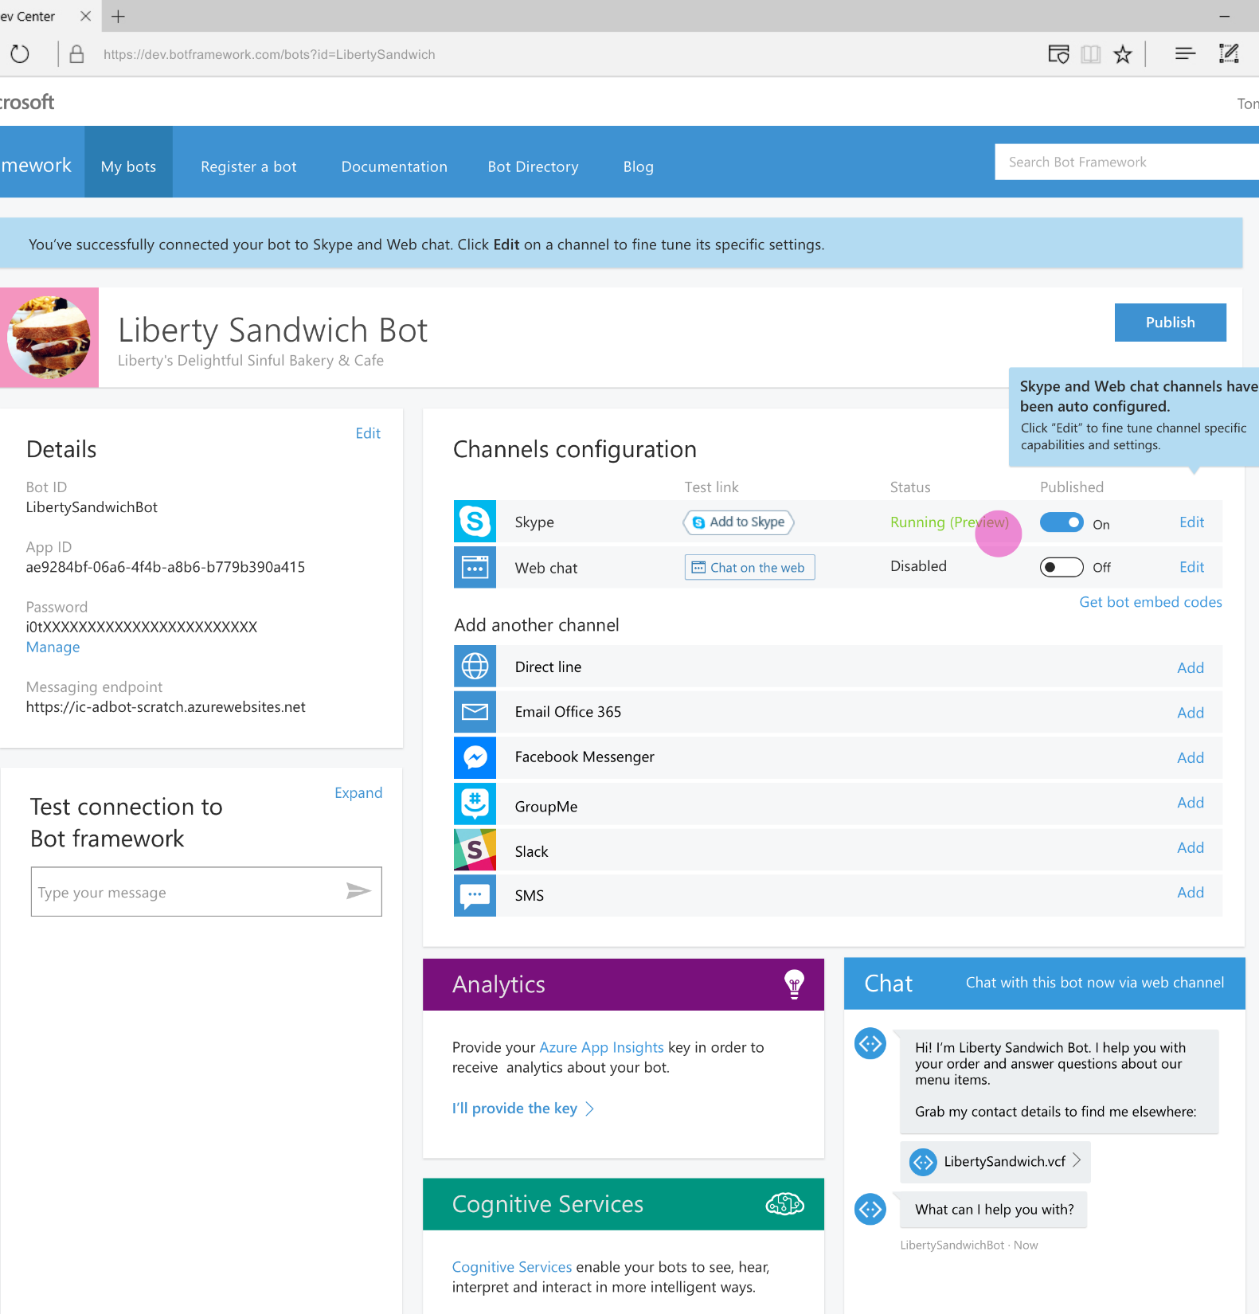
Bot Framework
Accelerate development
Framework, tools and services to build great bots that converse naturally
Reach any user
Develop once and expose through any channel including Skype, Facebook, web
Enrich the experience
Add advanced capabilities through close integration with Cognitive Services

Slide 29
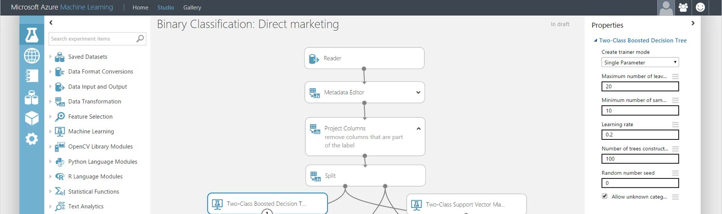
Azure Machine Learning
Integrated environment
Best-in-class algorithms
Deploy in minutes
Simple drag, drop, and connect interface for Data Science
Built-in collection of best-of- breed algorithms. R, CRAN packages, and Python
Train and operationalize models with a single click

Slide 30
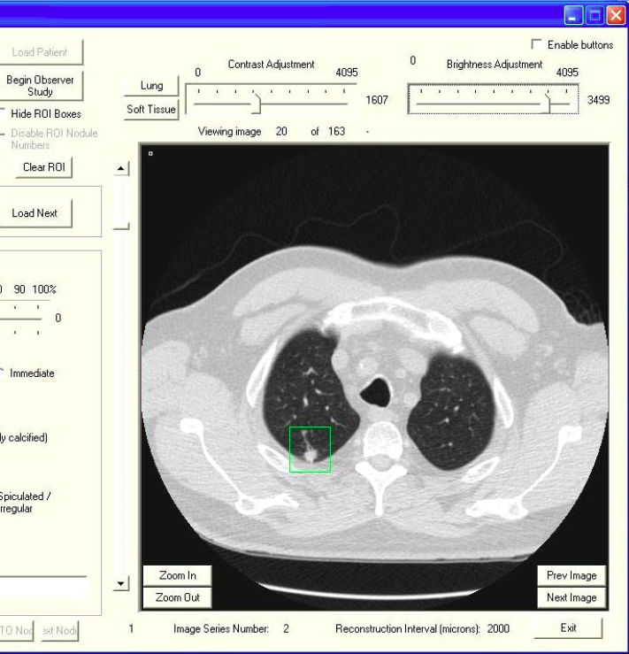
Deep Learning
Open environment
Cognitive Toolkit: performance, scale
Full support for TensorFlow, Caffe
Productive tools
Visual Studio
Jupyter Notebook
Azure AI infrastructure
The AI supercomputer: CPU, GPU, and (coming next) FPGA
Managed service with Batch AI Training

Slide 31
Developer Landscape
Cognitive Services
Customizable Cognitive Services
Azure Machine Learning
Cognitive Toolkit (CNTK)

Slide 32
Comprehensive data for your business
Comprehensive data

Slide 33
Enterprise-proven
technologies
practices
Business solutions
business model

Slide 34
AI Platform
Comprehensive data
Business solutions

Slide 35
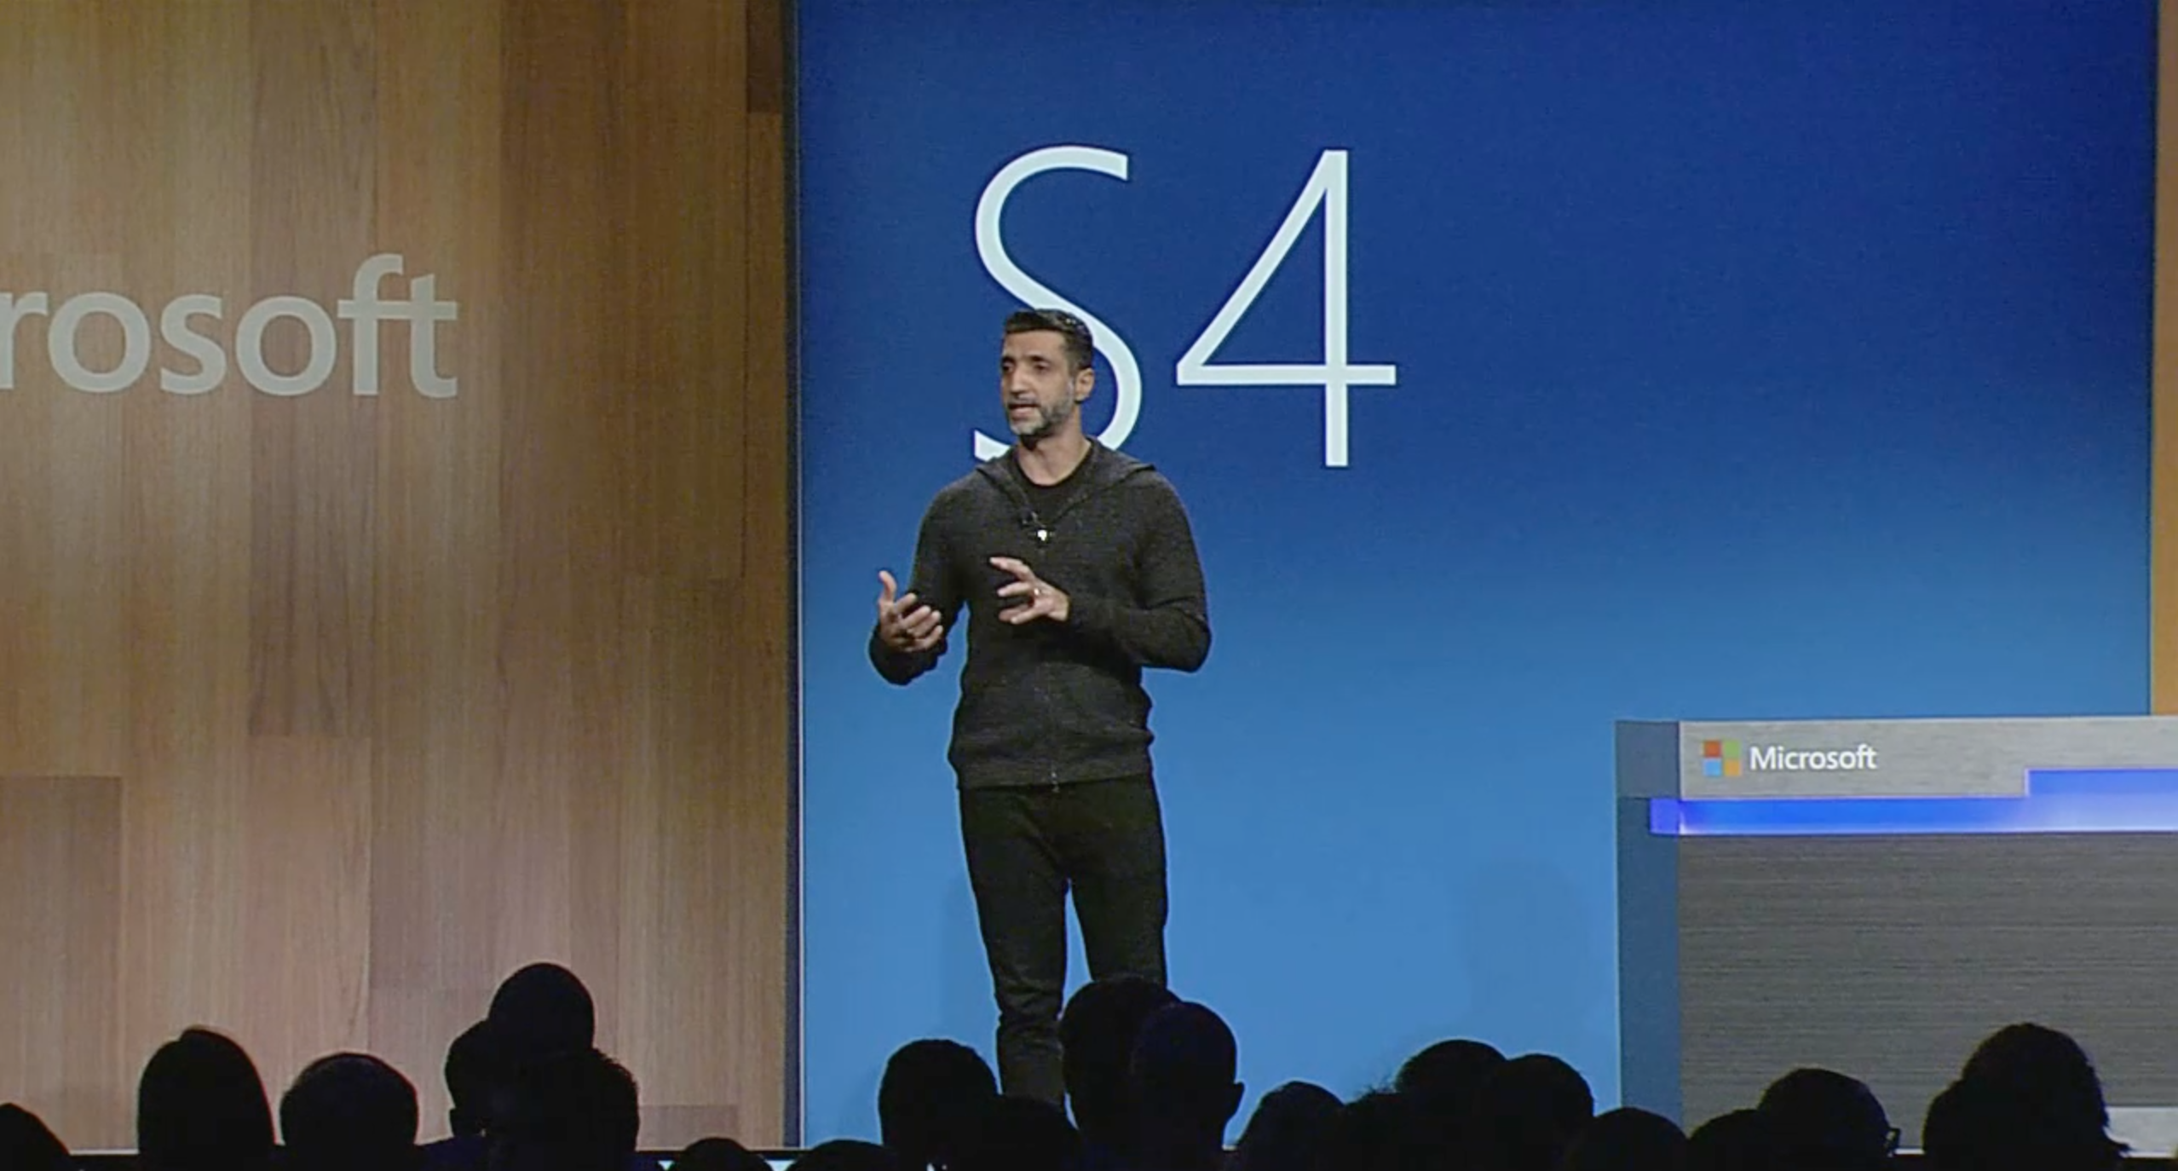
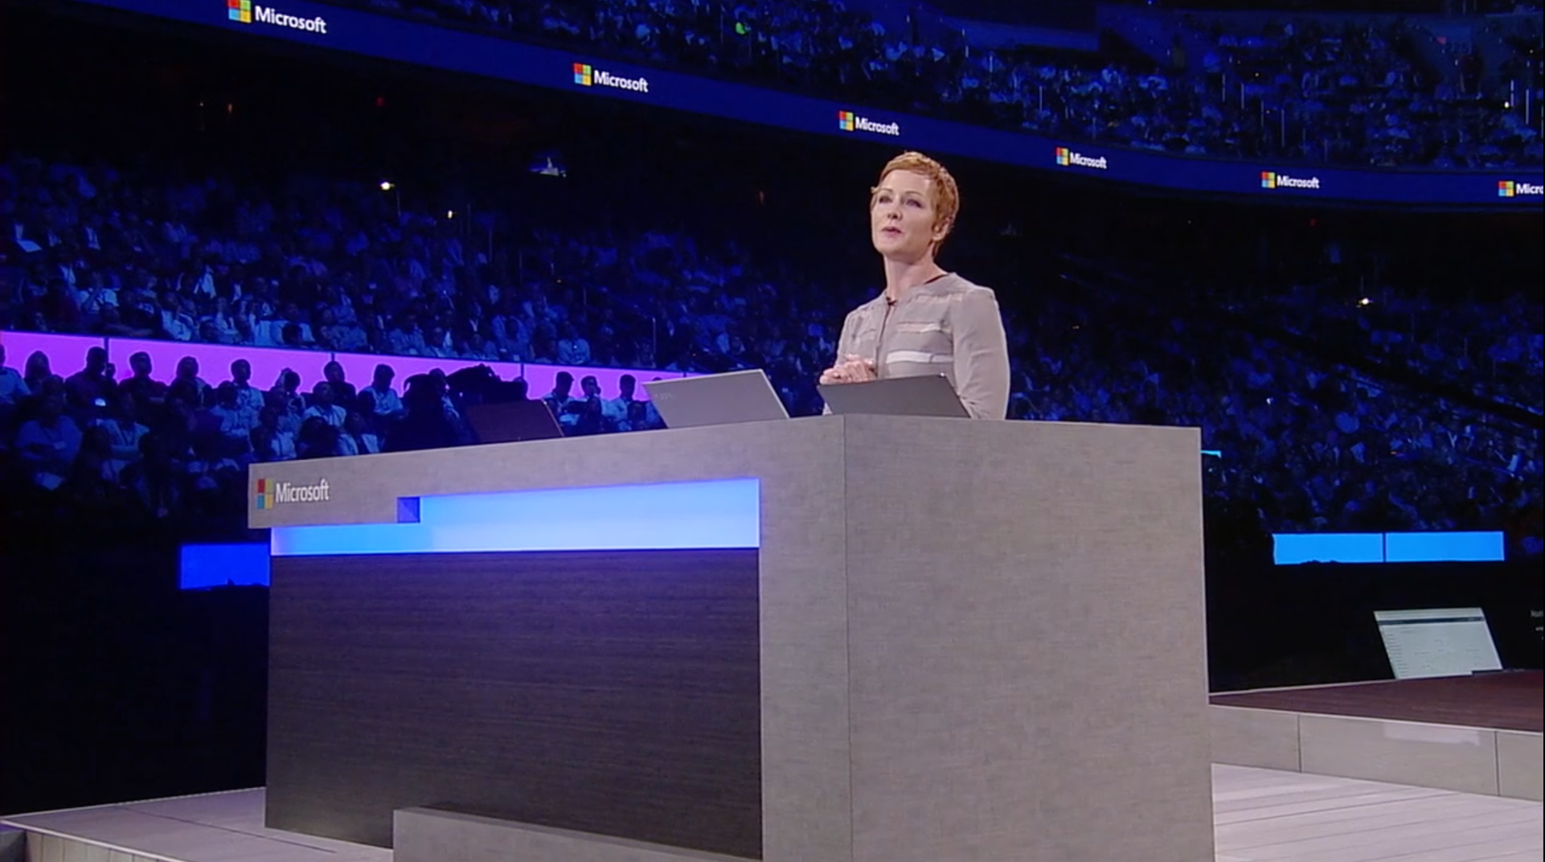
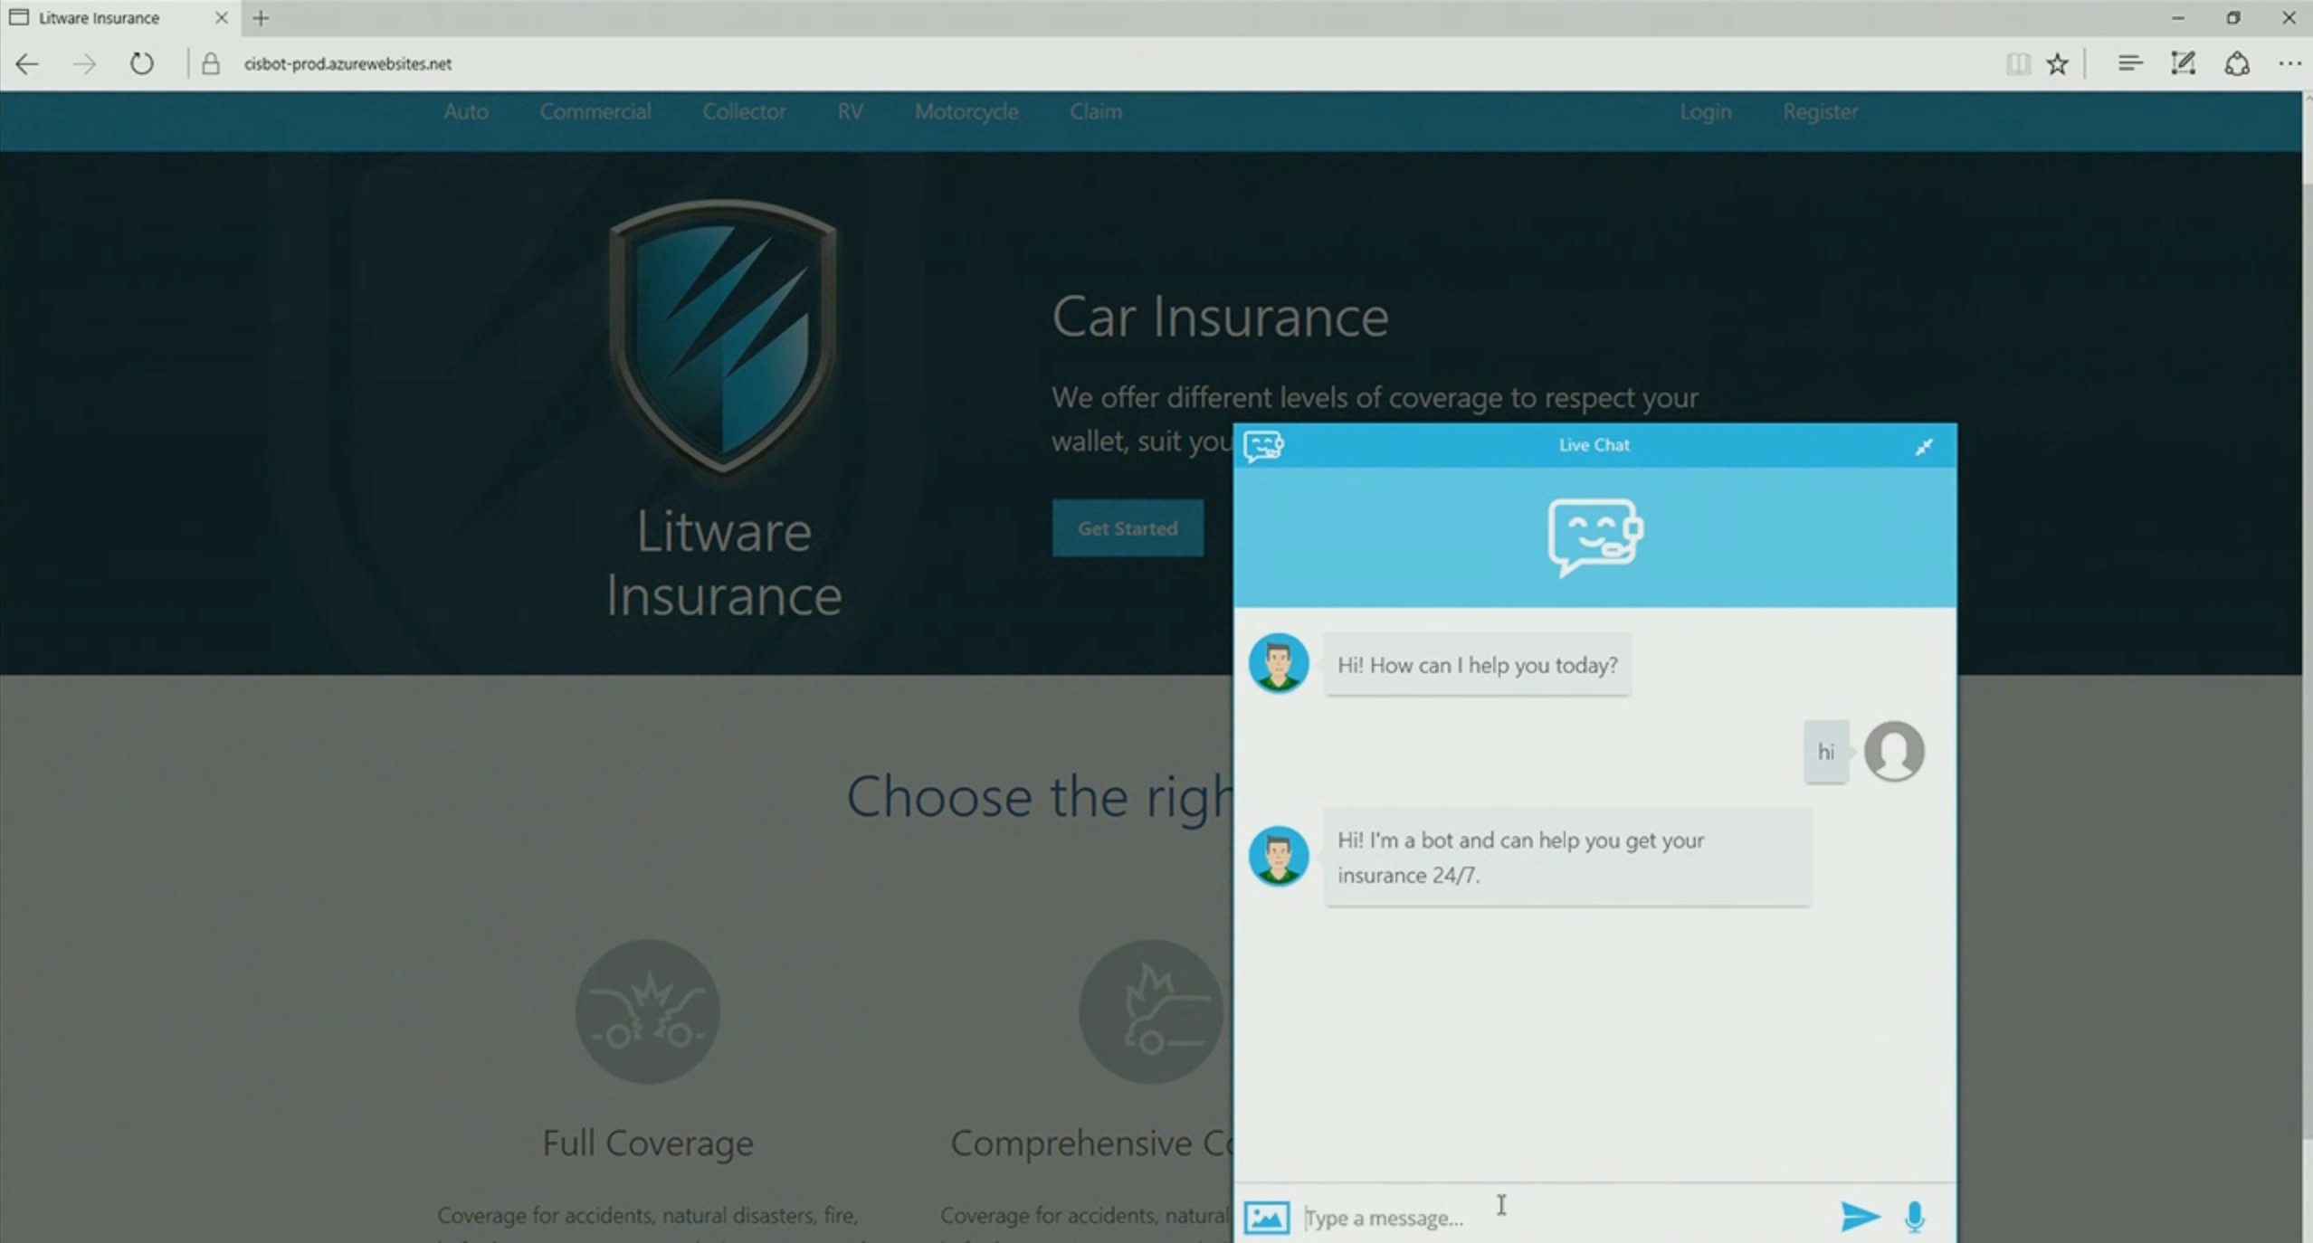
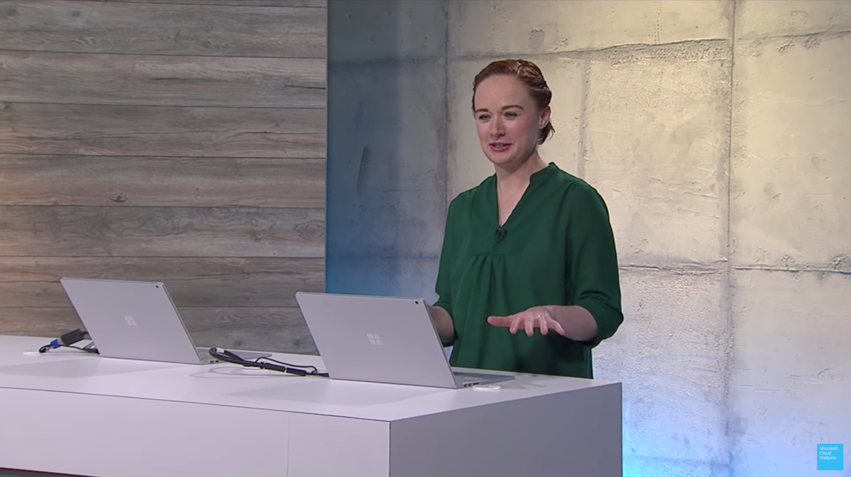
Demo
Litware Insurance

Slide 36
Dynamics 365
Skype
Browser
Azure Bot Service
Cognitive Services
Cortana
Web
Azure ML

Slide 37
Language
Module 2
Module 1
Dynamics 365
Skype
Knowledge
Module 3
Speech
Browser
Azure Bot Service
Cognitive Services
Module 4
Vision
Cortana
Web
Module 5
Azure ML
Cognitive Toolkit

